Slide 1
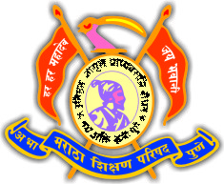

Anantrao Pawar College Of Engineering & Research,Pune.
Department of Information Technology BE Project Academic Year 2021-22
ASL Translation using Mediapipe and SVM
For Kids
Presented By
Project Guide: “Prof.S.R.Kokane”
Day and Date:Monday 09 May 2022
Veda Chiluka | (71922927J)
Vaishnavi Mate | (72011194D)
Sakshi Jagtap | (71922952K)
Om Darvitkar | (72011185E)

Slide 2
Contents
Problem Statement
Motivation
Objective
Literature Survey
Specifications
System Architecture
UML Diagrams
Implementation
Methodology
Result
Test Cases
Conclusion
References

Slide 3
Introduction
The world is hardly alive without communication, no matter whether it is in the form of texture, voice or visual expression.
The communication among the hearing impaired and normal person is carried by text and visual expressions.
Gestural communication is always in the scope of confidential and secure communication.
Hands and facial parts are immensely influential to express the thoughts of human in confidential communication.
This proposed system helps children to learn the sign language by themselves.

Slide 4
Problem Statement
Understanding the exact context of symbolic expressions of hearing impaired person is the challenging job in real life until unless it is properly specified.

Slide 5
Motivation
Sign language is learned by hearing impaired person, and usually it is not known to normal people, so it becomes a challenge for communication between a normal and hearing impaired person.
Its strike to our mind to bridge the gap between hearing impaired and normal people to make the communication easier.
Many children loss hearing ability ,it can be because of genetics or because of some other medical issues.
Hence to teach those kids a sign language we have created this system.

Slide 6
Objective
Research has found that the use of signs and finger will accommodate a wide range of learning styles: “verbal linguistic,” kinesthetic” and “interpersonal.” Using ASL is the representation of information through seeing, hearing, and movement, and the more pathways that are created in the brain, the stronger the memory.
The objective of this project is to make the hearing impaired person teach himself American sign language at home without attending any physical classes.

Slide 7
Literature Survey
Sr. no | Reference Name | Description | Drawbacks
1 | Real-time Conversion of Sign Language to Text and Speech. (ICIRCA),6 | Sept 2020 | It Includes Image Processing using OpenCV followed by SVM model predicting the output. | It takes a long way for Image Processing which includes segmentation, Thresholding, Contouring, Feature processing and Extraction.
2 | Sign Language Recognition using Mediapipe. (IRJET), 01 | Jan 2022 | It Includes sign language recognition using OpenCV,Mediapipe, tensorflow, keras etc with KNN Algorithm.Mediapipe achieves an average accuracy of 95.7% palm discovery. | It doesn’t work well with large datasets and high dimentions data.

Slide 8
Literature Survey Continued..
Sr. No. | Reference Name | Description | Drawbacks
3 | Sign Language Recognition Using Mediapipe Framework with Python. (IJSRD), 3 | 2021 | Sign Language using Mediapipe and recognition through computer vision was a partly successful one with an accuracy rate of average 17 FPS and accuracy on an average is 86 to 91 %. | It needs feature scaling during image processing if not done may result in wrong prediction.
4. | Thai Sign Language Recognition: an Application of Deep Neural Network (IEEE),25 June 2021 | .The result showed that the model builds with LSTM, BLSTM and GRU has an accuracy greater than 90 percent. This approach can produce an accurate close to the traditional approach. | There are some limitations in binding to the MediaPipe Framework.

Slide 9
Specifications
Software Specifications
Operating system: Windows 7 and above
Coding Language : Python, Html, CSS
IDE: VS Code, Pycharm IDE
Libraries: OpenCV, MediaPipe, NumPy, Pandas and Sklearn.
Hardware Specifications
Webcam
Framework
Flask
Database
Firebase
Domain
Machine Learning
Deep Learning

Slide 10
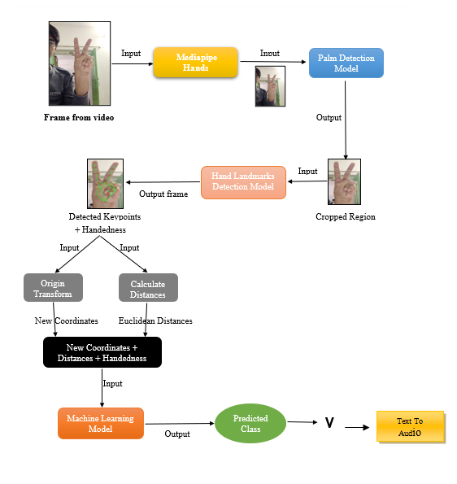
System Architecture

Slide 11
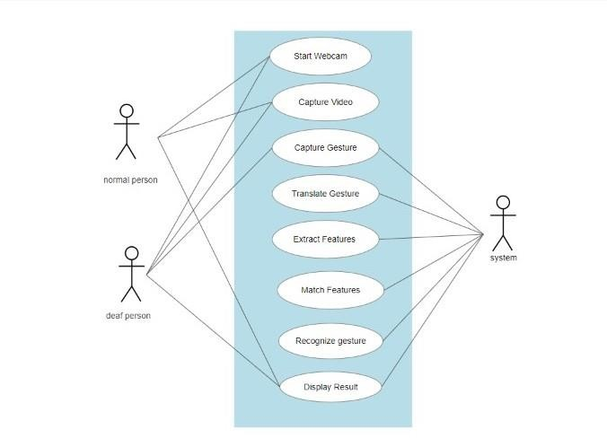
1.Use Case Diagram
UML Diagrams

Slide 12
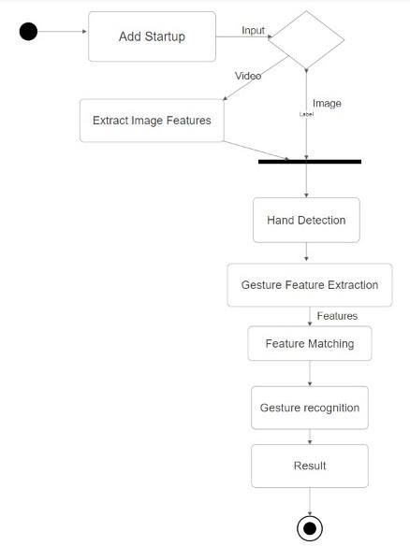
2.Activity Diagram

Slide 13
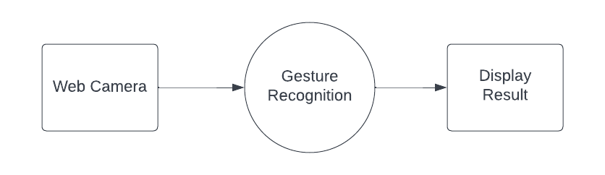
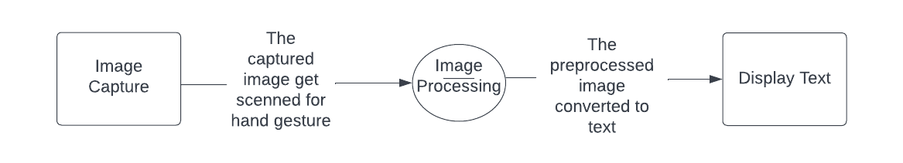
3.Data FlowDiagram
3.1.Level 0 DFD
3.2.Level 1 DFD

Slide 14
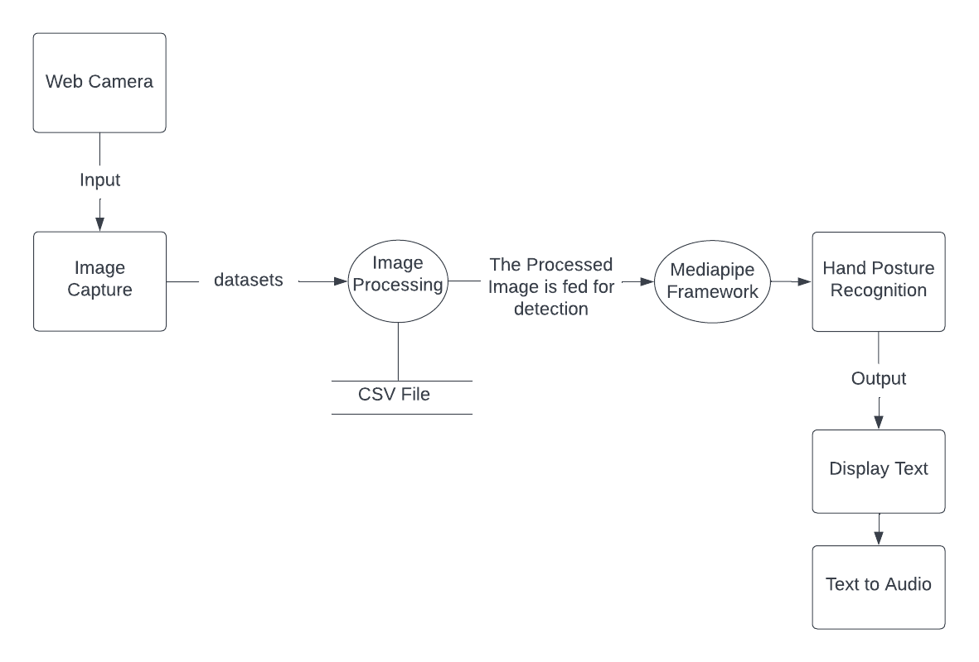
3.3.Level 2 DFD

Slide 15
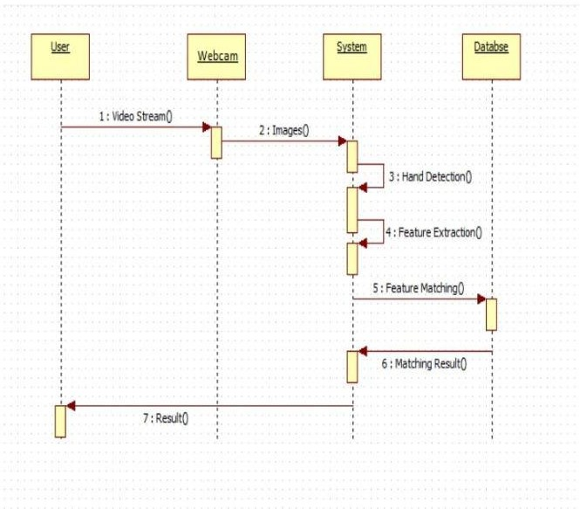
4.Sequence Diagram

Slide 16
Implementation
TOOLS AND TECHNOLOGY USED:
Python Libraries:
OpenCV: It is a huge open-source library for computer vision, machine learning, and image processing.
Flask: It is a web application framework written in Python. Flasks design is lightweight and modular. Therefore, it is easy to transform it into the web applications or framework when one needs very few extensions without weighing much
Scikit-learn: It provides a selection of efficient tools for machine learning and statistical modeling including classification, regression, clustering and dimensionality reduction via a consistence interface in Python.

Slide 17
NumPy: It is a Python library used for working with arrays. It also has functions for working in domain of linear algebra, fourier transform, and matrices.
Pandas: Pandas is a Python library used for working with data sets. It has functions for analyzing, cleaning, exploring, and manipulating data.
Mediapipe: It is a python library to detect face and hand landmarks. We will be using a Holistic model from mediapipe solutions to detect all the face and hand landmarks.

Slide 18
Methodology
1.Image Processing
Capture Image through camera
Apply OpenCV libraries.
Converted the captured hand gesture from BGR to RGB and used mediapipe and convert it again from RGB to BGR

Slide 19
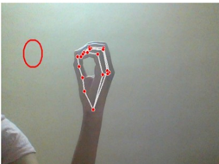
Mediapipe Framewrok
Media Pipe Hands is a high-fidelity hand and finger tracking solution. It employs machine learning (ML) to infer 21 3D landmarks of a hand from just a single frame.

Slide 20
2.Support Vector Machine(SVM)
SVM is one of the most popular Supervised Learning algorithms, which is used for classification as well as Regression Problems.
The main objective is to segregate the given dataset in the best possible way.
The objective is to select a hyperplane with the maximum possible margin between support vectors in the given dataset.

Slide 21
Components of SVM
Support Vectors : Support vectors are the data points, which are closest to the hyperplane. These points will define the separating line better by calculating margins.
Hyperplane : A hyperplane is a decision plane that separates between a set of objects having different class memberships.
Margin : A margin is a gap between the two lines on the closest class points. This is calculated as the perpendicular distance from the line to support vectors or closest points. If the margin is larger in between the classes, then it is considered a good margin, a smaller margin is a bad margin.

Slide 22
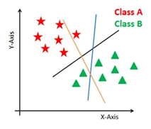
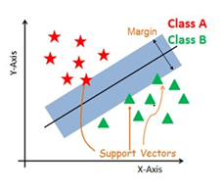
How it SVM works?
It generates the hyperplanes that segregate the classes in the best way. First figure showing three hyperplanes black, blue, and orange. Here, the blue and orange have higher classification errors, but the black is separating the two classes correctly.
Select the right hyperplane with the maximum segregation from the either nearest data points as shown in the second figure.
Fig 1.
Fig 2.

Slide 23
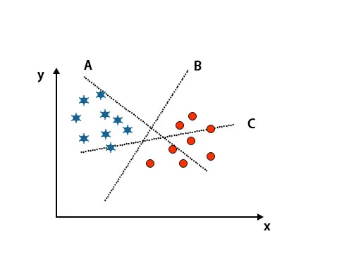
Scenario 1: Identify the right hyper-plane
Here we have taken three hyper-planes, i.e., A, B and C. Now we have to identify the right hyper-plane to classify stars and circle.
To identify the right hyper-plane, we should know the thumb rule. Select hyper-plane which differentiates two classes. In the above-mentioned image, hyper-plane B differentiates two classes very well.

Slide 24
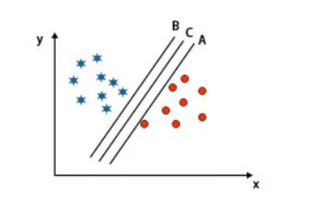
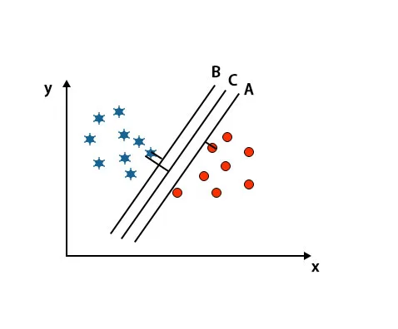
Scenario 2: Identify the right hyper-plane
Here we have taken three hyper-planes, i.e. A, B, and C. These three hyper-planes are already differentiating classes very well.
In this scenario, we increase the distance between the nearest data points to identify the right hyper-plane. This distance is nothing but a margin. Refer to the below image.
In the above-mentioned image, the margin of hyper-plane C is higher than the hyper-plane A and hyper-plane B. So in this scenario, C is the right hyperplane. If we choose the hyperplane with a minimum margin, it can lead to misclassification. Hence we chose hyperplane C with maximum margin because of robustness.

Slide 25
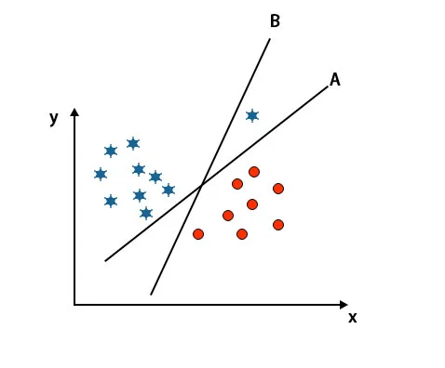
Scenario 3: Identify the right hyper-plane
As you can see in the above-mentioned image, the margin of hyper-plane B is higher than the margin of hyper-plane A; that’s why some will select hyper-plane B as a right. But in the SVM algorithm, it selects that hyper-plane which classify classes accurate prior to maximizing margin. In this scenario, hyper-plane A has classified all accurately, and there is some error With the classification Of hyper-plane B. Therefore, A is the right hyper-plane.

Slide 26
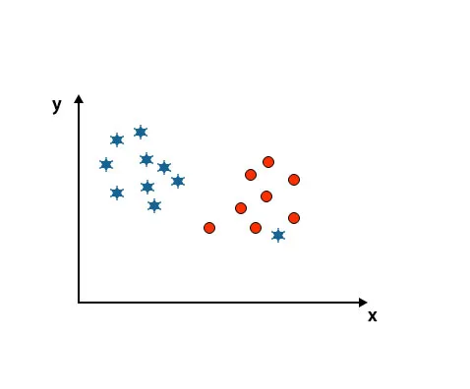
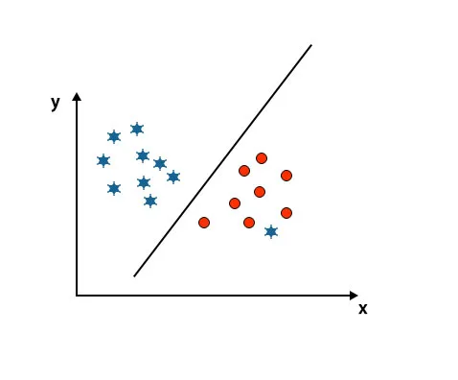
Scenario 4: Classify two classes
As you can see in the below-mentioned image, we are unable to differentiate two classes using a straight line because one star lies as an outlier in the other circle class.
Here, one star is in another class. For star class, this star is the outlier. Because of the robustness property of the SVM algorithm, it will find the right hyperplane with a higher margin ignoring an outlier.

Slide 27
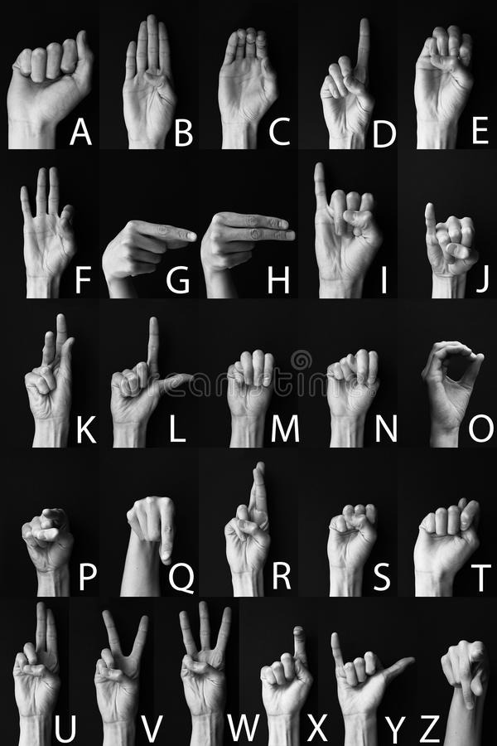
3.DataSets
Fig: Datasets for A-Z alphabets

Slide 28
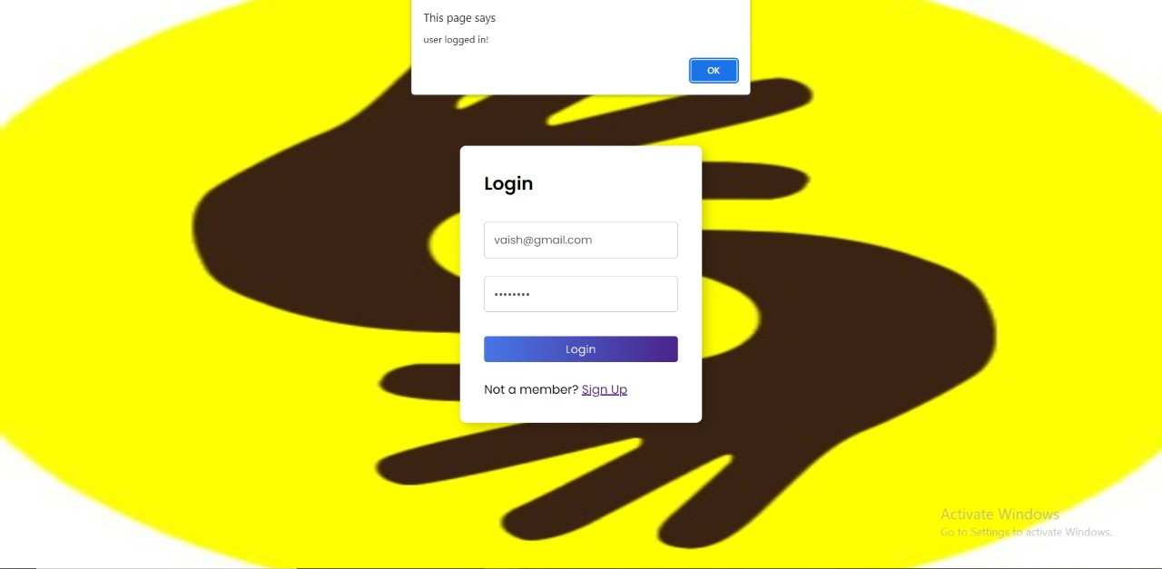
Result
Fig1:User Login Successful

Slide 29
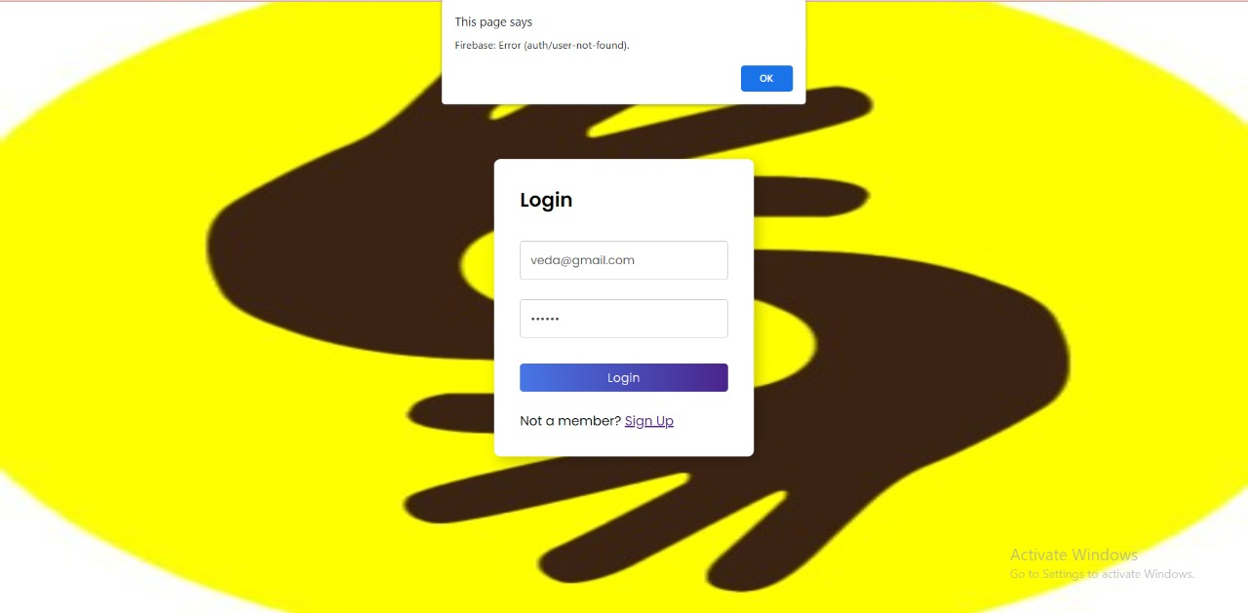
Result
Fig2:User Login Failed

Slide 30
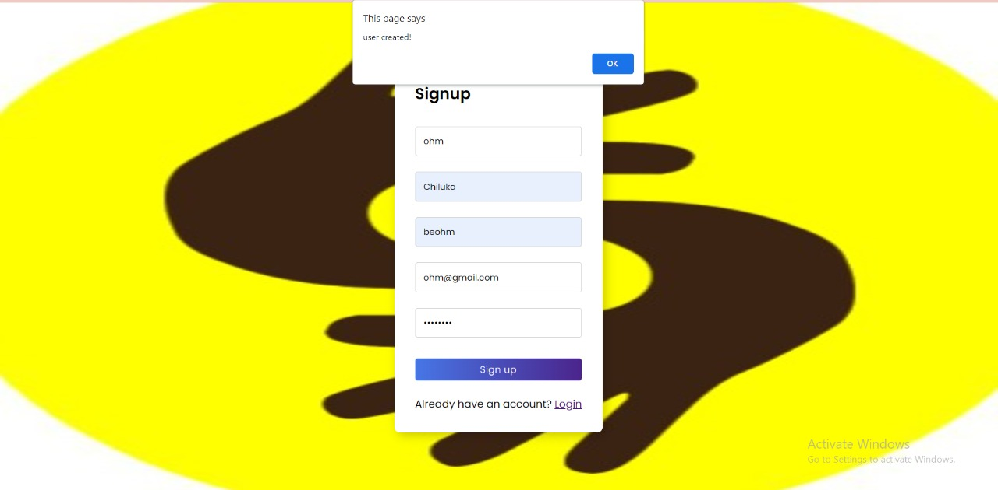
Result
Fig3: Sign Up User

Slide 31
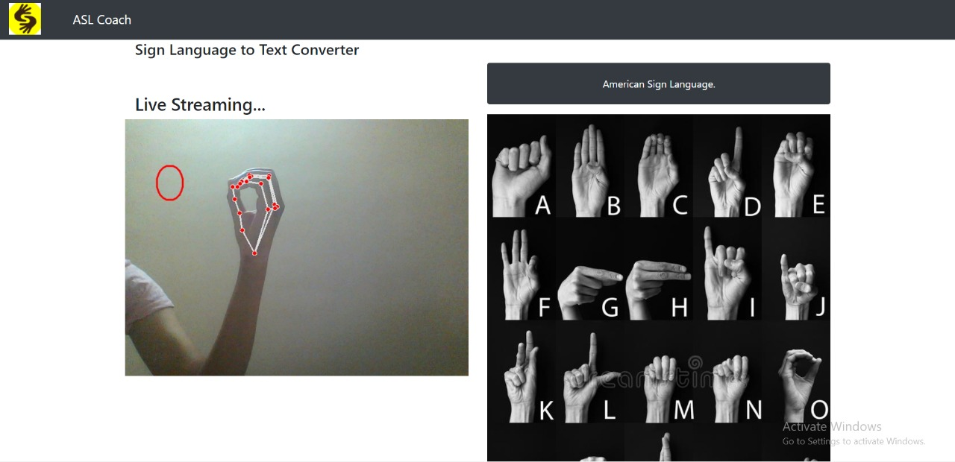
UI Design
Fig: Detection of Sign Language

Slide 32
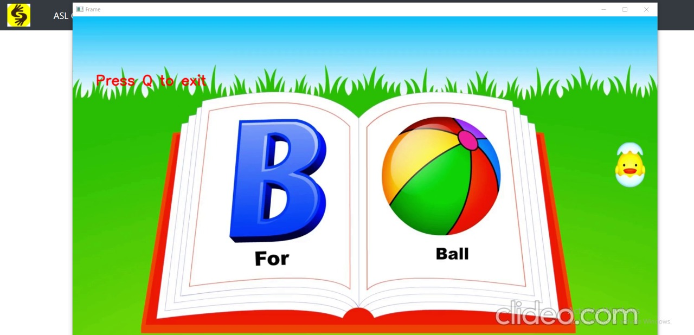
UI Design

Slide 33
Test Cases
Login Test Cases
Sr.no | Test Case | Expected Result | Actual Result | Final Result
1. | Verify if user is able to login with valid username and password | User should get login in only after valid username and password | User get logged in with valid username password | Pass
2. | Verify the message for invalid Login | Pop up should be generated for invalid username or password | Pop up get displayed for invalid username or password | Pass
4. | Verify if the data in the password field is either visible as asterisk or bullet signs | Password should remain hidden | While entering the password it display in asterisk | Pass
3. | Verify if the page retrieve to next page after login | Next page should be display after clicking on “Login”button | Next page get displayed after Login | Pass

Slide 34
2.SignUp Test cases
Sr.No | Test Cases | Expected Result | Actual Result | Final Result
1. | Verify valid Gmail | The field should show error if user enter invalid gmail | It shows error if the gmail is valid | Pass
2. | Password Length | Passowrd should be contain atleast 6 Character | It shows error if password length is less than 6 | Pass
3. | Verify if the data in the password field is either visible as asterisk or bullet signs | Password should remain hidden | While entering the password it display in asterisk | Pass

Slide 35
Feasibility Study
Technical Feasibility
Framework: We will be using Flask which is the high level python Framework that enables rapid development of secure and maintainable applications.
Backend: we will be developing application in python backend so it will be easier to deploy the application so that it can handle heavy workload.
Operational Feasibility
Process: How do the end user feel about the project that is implemented?
Input and analysis from everyone the new redesign will affect along with a data matrix on ideas and suggestions from the original plans.
Possibility of Project Implementation: Yes, there are many technical tasks which we need to handle but technically these project can deployed successfully.

Slide 36
Feasibility Study
Economic Feasibility
Cost Analysis: Software license purchase costs, Software deployment costs.
Scheduling Feasibility
Timeline Estimations: Assuming efforts by all the teammates will surely result into completing the project on time..

Slide 37
Conclusion
Thus we have implemented the system for sign language detection for children to make themselves learn sign A-Z Alphabets .
The proposed system is implemented using Media Pipe Framework which is used for detection and SVM Techniques which is use for classification.

Slide 38
Future Scope
As of now the proposed system includes on Alphabets A-Z, But in future we are planning to add numbers, continuous action, expressions to form a sentence and words like good morning, hello, bye, etc., so that the children will be able to learn more sign language expressions quickly.

Slide 39
References.
[1] Kohsheen Tiku, Jayshree Maloo, Aishwarya Ramesh & Indra R “Real-time Conversion of Sign Language to Text and Speech” (ICIRCA-2020)
[2] Ketan Gomase1, Akshata Dhanawade2, Prasad Gurav3, Sandesh Lokare4 “Sign Language Recognition using Mediapipe” (09 Issue: 01 | Jan 2022)
[3] Adarsh Vishwakarma1 Niraj Yadav2 Prajnay Yadav3 Vaibhav Singh4 “Sign Language Recognition Using Mediapipe Framework with Python” (Vol. 9, Issue 3, 2021)
[5]https://ijarcce.com/wpcontent/uploads/2020/06/IJARCCE.2020.9535.pdf
[6] https://www.ijisrt.com/assets/upload/files/IJISRT20MAY944.pdf
[7] https://ieeexplore.ieee.org/document/9182877
[8] http://cs231n.stanford.edu/reports/2016/pdfs/214_Report.pdf
[9] http://www.iosrjen.org/Papers/vol3_issue2%20(part-2)/H03224551.pdf
[10] https://youtu.be/4m4h2E7cQ64

